Slide 1

P2P Loan Analytics
Sai Sudheer Neelam
Anthony Keith clear

Slide 2
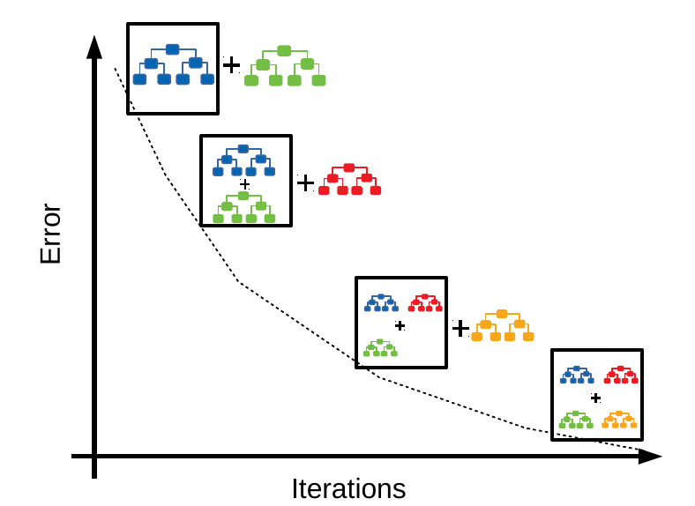
Algorithm
Gradient Tree Boosting
Gradient Boosting is an ensemble learning method that builds multiple decision trees sequentially, where each tree corrects the errors of the previous ones.
This algorithm builds an additive model in a forward stage-wise fashion; it allows for the optimization of arbitrary differentiable loss functions

Slide 3
Modelling Choices
This model is trained with specific hyperparameters
n_estimators: Number of boosting stages (trees) to be used in the ensemble.
learning_rate: The rate at which the model's weights are updated during training.
max_depth: Maximum depth of the individual decision trees.
random_state: Random seed for reproducibility.
The Gradient Boosting Classifier model is trained using the selected features and the training data.

Slide 4
Variable Importances
The variable selection process is based on their relevance to loan default prediction.
Some of the variables included in this list are one the right panel.
Without the specific output of feature importance from the trained model, we cannot precisely identify the actual important variables.
However, based on the features used in the model training process, the variables listed are likely to be among the important ones
prosper_rating : The amount of money borrowed by the borrower.
borrower_rate : The interest rate associated with the loan.
loan_status : The FICO credit score of the borrower.
prosper_score : The Prosper score assigned to the borrower.
income_range : The income range of the borrower.
employment_status_description : The employment status of the borrower.
Occupation : The occupation of the borrower.
is_homeowner : Indicates whether the borrower is a homeowner.

Slide 5
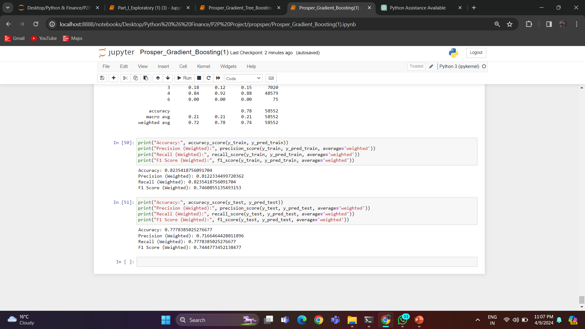
Model Performances In Sample
To evaluate the performance of this model several evaluations are considered
Accuracy : Measures the proportion of correctly predicted instances out of the total instances.
Precision : Measures the proportion of true positive predictions out of all positive predictions
Recall (Sensitivity): Measures the proportion of true positive predictions out of all actual positive instances.
F1 score : It is the harmonic mean of precision and recall.
confusion matrix provides a tabular summary of the model's predictions versus the actual labels

Slide 6
Out of Samples (OOS)
Receiver Operating Characteristic (ROC) Curve and Area Under the Curve (AUC)
ROC curve is a graphical plot that illustrates the performance of a binary classifier across different threshold values.
AUC represents the area under the ROC curve. A higher AUC indicates better performance.

Slide 7
Future Proceedings
Feature Engineering
Model Tuning
Ensemble Methods
Advanced Techniques
Model Interpretation
There are several potential future steps that could be taken to further enhance and improve the loan default prediction project.

Slide 8


